Slide 1
Sample Title Page
Employer Engagement Webinar Series
2. Consideration – Deepening the Employer Relationship
Kentucky Employment First
July 18, 2024

Slide 2
So how did you do…..

Slide 3
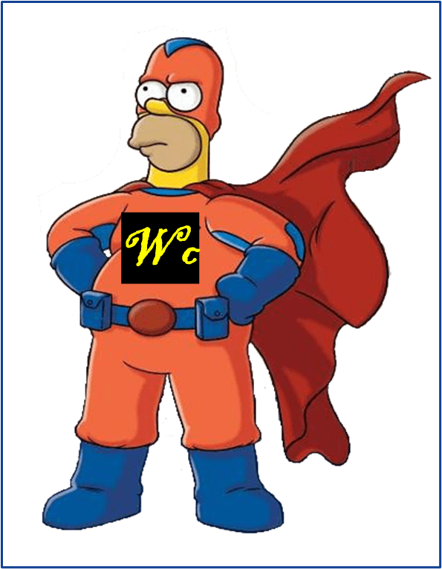
Recap Connecting Fundamentals
You are workforce development professionals
You work in consultative sales
You work to provide custom staffing solutions
You strive to “add value” for the business customers
You strive for long-term relationship building NOT just job hunting

Slide 4
5 Min Favor = Investment in relationship
Share an article of interest (email, LinkedIn, etc)
Better still provide synthesis and share an article
Introduce them to someone of interest….a peer in their field, someone who may want their product/service, possible employees (beyond your job seekers)
Send them a referral
Recommend the business to a colleague, peer agency, etc
Share, comment, repost their social media
Offer valuable feedback (about website, about product, etc)
Send them a restaurant recommendation, movie, book
https://www.forbes.com/sites/kareanderson/2013/07/17/pay-it-forward-with-the-five-minute-favor/

Slide 5
Major Phases of the Employer Engagement
1. Connection
2. Consideration
3. Conversion
4. Continuation
Adapted from: How to Master All 5 Stages of Customer Journey https://www.goldenvineyardbranding.com/blog/stages-of-the-customer-journey/

Slide 6
What are we trying to do?
Continue to develop & deepen rapport
Understand their fundamental business
Understand their challenges, pain points, log jams, etc
Understand what they’re not getting to do, what not providing, what customers expecting
Understand how their staff, recruit, onboard, etc
Understand how we can deliver value through a solid match

Slide 7
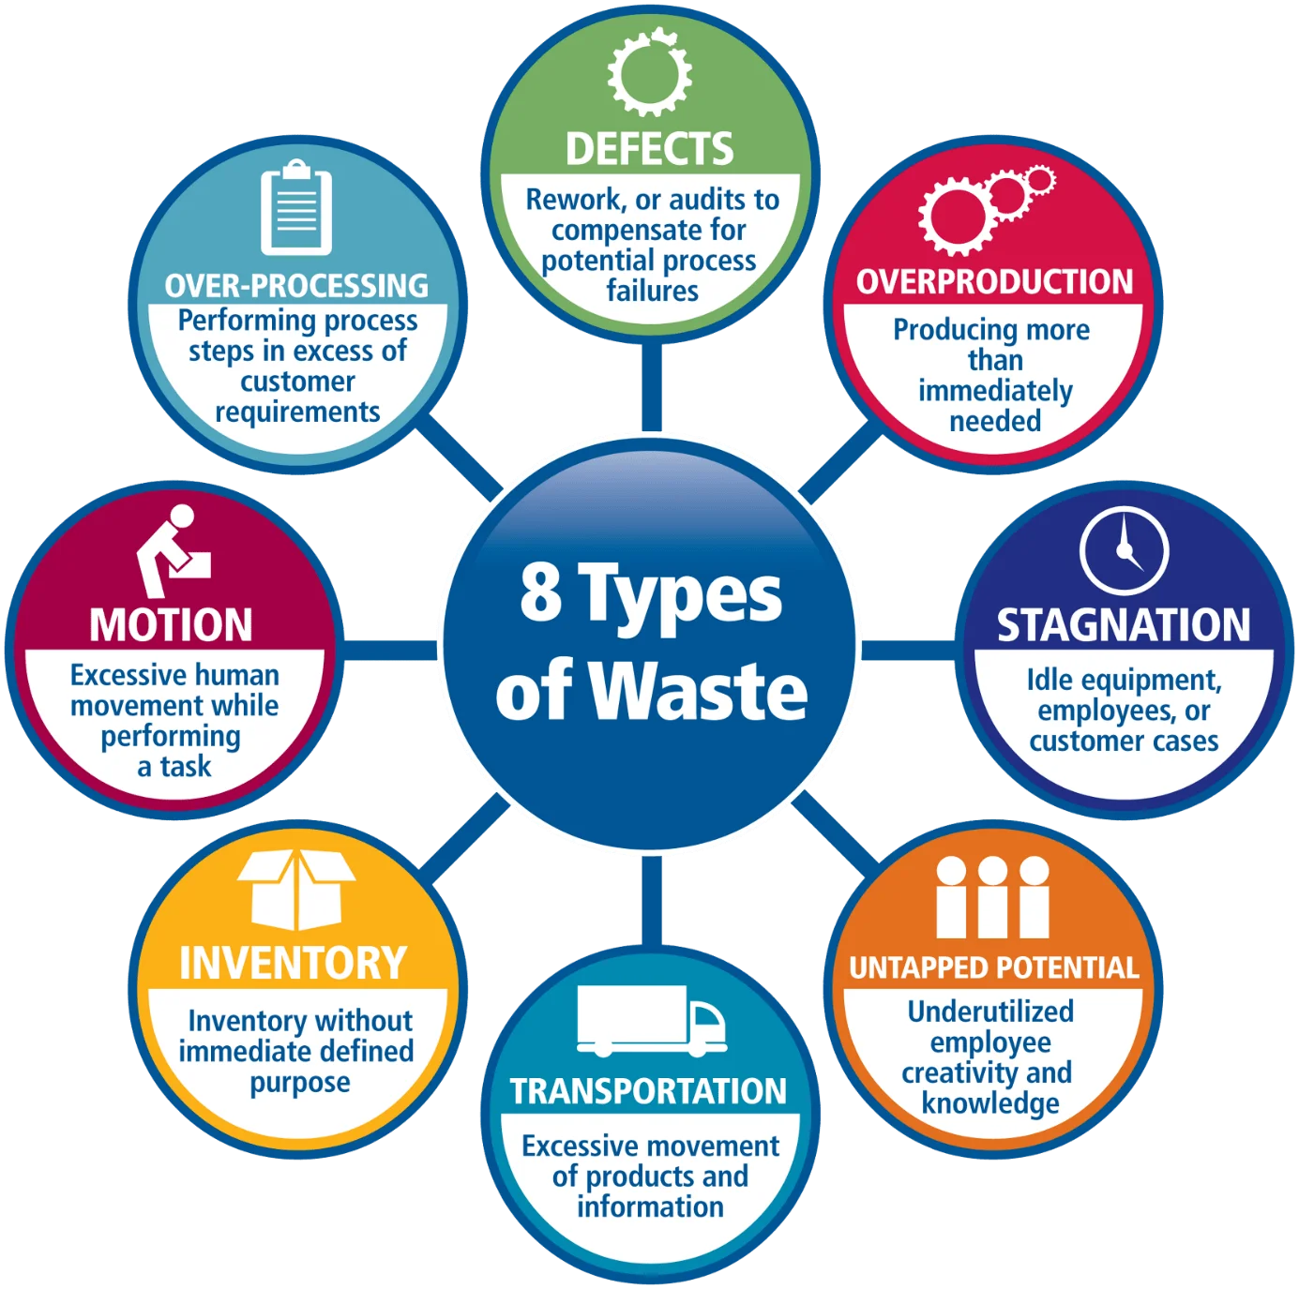
Overview-Considering
Back to Business Thinking
Curiosity (and Humble Inquiry)
LEAN thinking
Problem Finding vs Problem Solving
Job and Task Analyses
Ways to engage in interim
How to maintain relations for the longer term

Slide 8
Curiosity
73
Source: Ignite Your Curiosity: https://youtu.be/E9HZyIT6Z-4?si=qV1pWQmVjZbcEvJJbibi

Slide 9
Why Curiosity is Beneficial

Slide 10
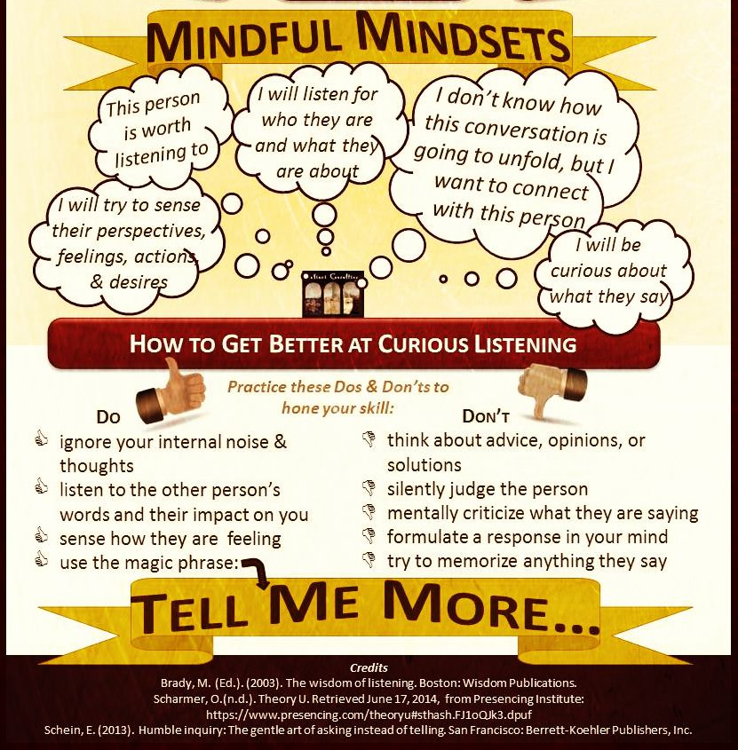
https://masterpieceleader.com/tag/humble-inquiry/

Slide 11
Break Out
Discuss questions you have/might ask to build rapport, get behind the scenes, to understand the business basics, and better understand their workforce needs AND deepen the connection!

Slide 12
Sample Questions
How did you get into this business/industry? (and maybe why?)
How did the business start?
What are your business’ challenges, “pain points”?
What does the business look like in 5, 10 years?
How do you find good talent?
What makes a good employee at your business?
How do you ensure talent grows and stays at your business?

Slide 13
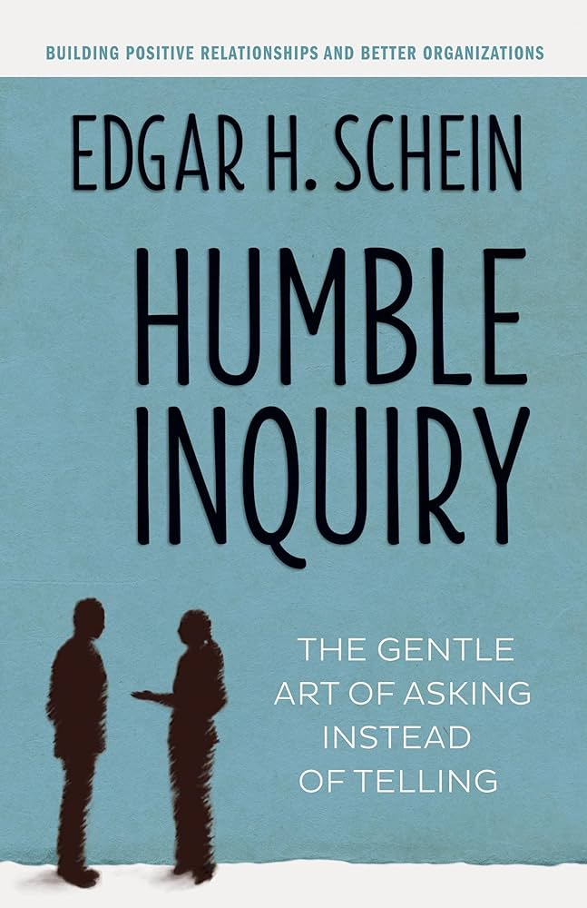
Humble Inquiry

Slide 14
Break

Slide 15
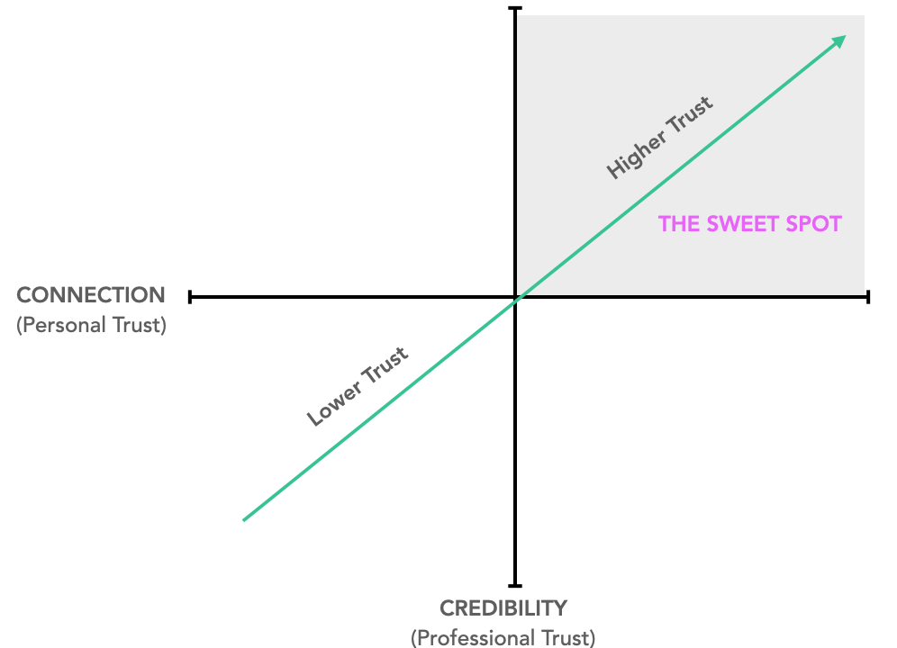
Partner Development
Partner
Friend
Trusted Advisor
Champion
Customer

Slide 16
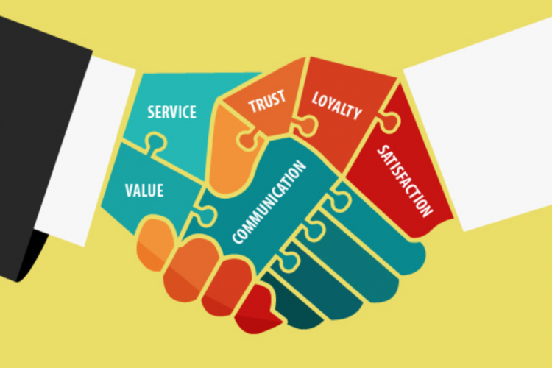
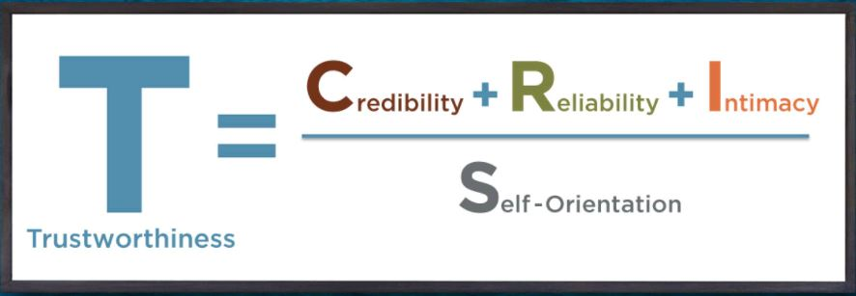
Trusted Advisor
Source: Trusted Advisor, David Maister

Slide 17
Think yourself a “Trusted Advisor”….
Increase Credibility
Show you’ve done your homework.
Take a point of view.
Speak the truth … always.
Increase Reliability
Combine your words with presence.
Make lots of small promises.
Be on time.
Use their terminology.
Develop Intimacy
Be willing to name the elephant in the room.
Listen with empathy.
Tell them something you appreciate about them.
Address people by name.
Lower Self Orientation
Give away ideas.
Build a shared agenda.
Steer clear of premature problem-solving.
Relax your mind.
Source: Trusted Advisor, David Maister

Slide 18
Why be this curious?
Staffing solution
Customizing staffing
Prescreened
Matched
Qualified
Onboarding & Orientation Support
Ongoing Support
What do we need to know to be able to do this?

Slide 19
Consideration in Practice
See The Business & Work Tasks
Understand The Job & Business
Find The Problem(s)
Deepen the relationship

Slide 20
Before You Go-Research
Basic web research about the company
Size, employees, services, customers, strategies,
Ancillary items- DEI, sustainability, community work
Beyond the company website…community news, economic development press,
Research the individual you’re meeting
LinkedIn is the first, and premier way to learn about a professional
Networks they are part of
Volunteer groups
Boards they maybe on
Professional and personal interests
Google may provide beyond professional networks

Slide 21
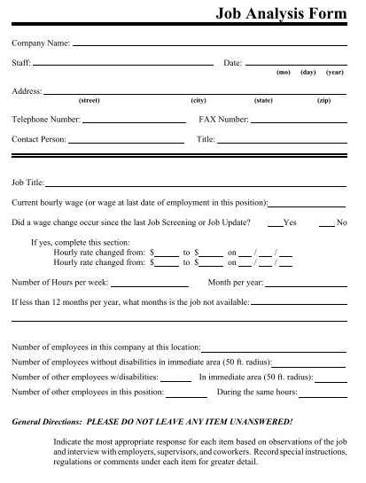
Job and Site Analyses
Job Duties
Job Expectations
Judgement/Decision Making Required
Job Schedule
Dress Code
Environment & Safety
Equipment used
Coworker/Supervisor Interaction
Culture
Pay
Benefits ($/non $)
Transportation

Slide 22
Using Lean Techniques to Find Problem

Slide 23
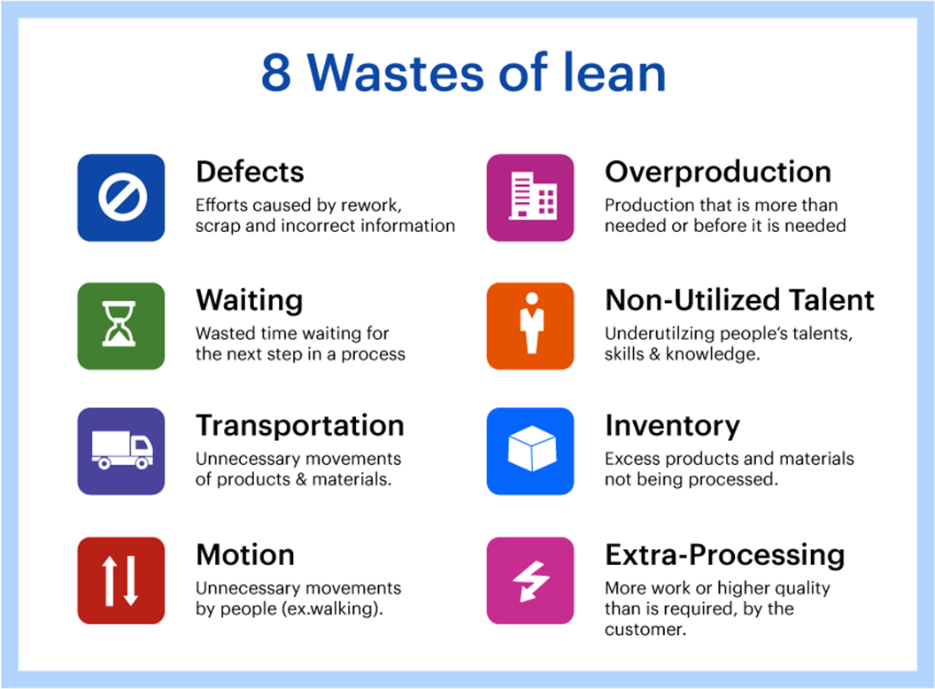
Break Out
How have you used ‘wastes’ to provide more value for your employer partner?
Notes:
7 mins

Slide 24
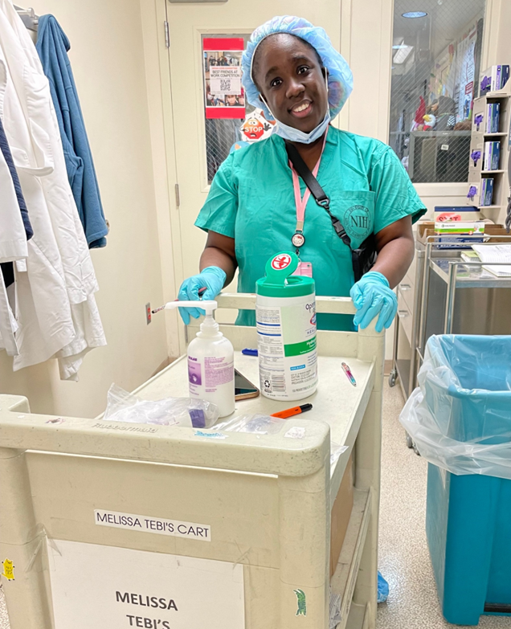
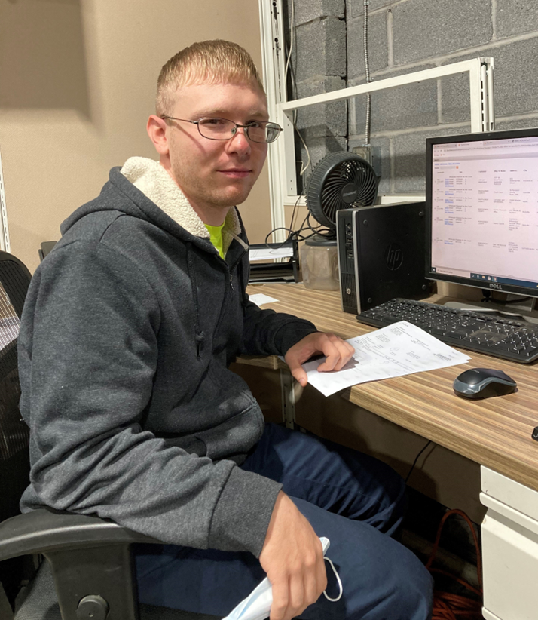
Remember you’re a Problem Finder……
Lost folders at Accounting firm
Towel maintenance at Hair Salon
Empty crash carts at NIH
Incorrect deliveries at Office Product supplier

Slide 25
After You Leave - Follow Up
“Thank you” communications – email most standard
Within messaging try to pull out insights
“Was so interesting to learn about the detail required to complete task XYZ”
“Thank you for highlighting the credentialing needed for the ABC role”
Within messaging state some actions/follow up
“I noted that there seemed some opportunities….”
“I have a job seeker interested in XYZ task that I’d love to set up a work trial”
“As I noted, we’d be excited to come back and do an Inclusive Education…”
“As you may recall, we have our NDEAM event coming up, that we’d like to invite you..
Follow Up (within a week, within a month)

Slide 26
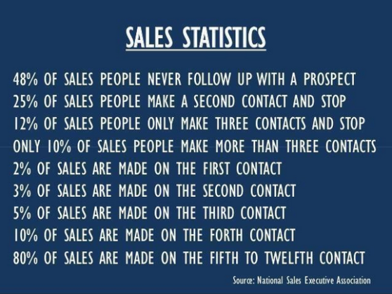
Just remember

Slide 27
Consultative Sales
Analyses and assessment is not for nought
You’ve got a ready to go tool to
Help provide some insights to your employer partner
Help identify maybe some problems, gaps,
Help filter your job seekers to MATCH work tasks, culture, etc
Something credible to share with the employerareas for opportunity
Something for you to reference when visiting other similar businesses (good/better/best practices)
So don’t throw this away
Notes:
Slide 27…..so these visits, the site tours, informational interviews….are critical…you are building a reference library of techniques, how work is organized or not….how work flows work or don’t….leveraging the idea of looking for those 8 DOWNTIME wastes will allow you to be a surprisingly good consultant…and also builds your mastery/knowledge and credibility….so spend sometime with the JAR/JSI, spend some time asking the questions (why is that there, what does that do, why do you do it that way)….

Slide 28
Consideration- Ways to further the conversation
Stakeholder Activities | Persons with Disabilities | Families | Providers | Sector/ Industry Leaders | State Officials/ Schools
Create Professional Mentoring Options |  |  | X | X | X
Create Work-Based Learning Options |  |  | X | X | X
Establish Business Advisory Council |  | X | X | X | X
Create Career Exploration Options |  | X | X | X
Hear from Successful Employer Activities | X | X | X | X | X
Invite to Education Activities | X | X | X | X | X
Invite to Recognition/ Celebration Activities | X | X | X | X | X

Slide 29
Recap
Curiosity is critical in relationship building
You want to be thought of as a “Trusted Advisor”
Lean into understanding their business
Work with your employer partner in problem-finding
Be diligent in your job/business analyses
Follow up (and follow up)
Continue giving throughout the process

Slide 31
So what you gonna do……

Slide 32
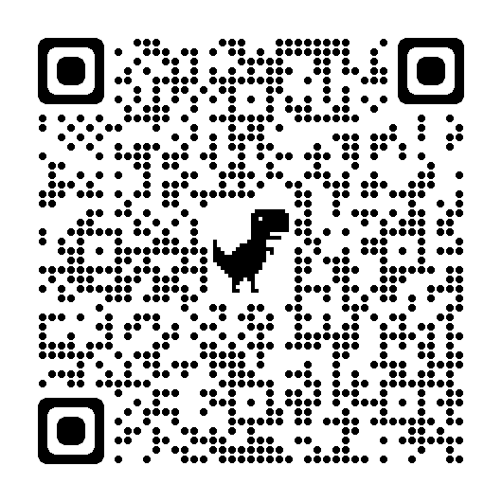
Steve Blanks
Director of Partnerships
SEEC
sblanks@seeconline.org
https://www.linkedin.com/in/steve-blanks-5a16474/details/skills/?detailScreenTabIndex=0

Slide 33
Resources
Curiosity & Inquiry Books
A Curious Mind-Brian Grazer https://www.amazon.com/Curious-Mind-Secret-Bigger-Life/dp/1476730776
SEEK-How Curiosity can Transform Your Life- Scott Shigeoka https://www.amazon.com/Seek-Curiosity-Transform-Change-World/dp/153874080X
Humble Inquiry –Edgar Schein https://www.amazon.com/dp/1523092629?k=humble%20inquiry&ref_=nb_sb_ss_w_scx-ent-pd-bk-d_l_k0_1_9&crid=31SWX6TTS07R3&sprefix=humble%20in
Coaching Habit –Michael Bungay Stanier https://www.amazon.com/dp/0978440749?k=coaching%20habit&ref_=nb_sb_ss_w_scx-ent-pd-bk-d_l_k0_1_14&crid=23VZICJS9MCOB&sprefix=coaching%20habit
How to Know a Person- Brooks, D https://a.co/d/2g9g09J

Slide 34
Resources
Job Analyses
Job Developer’s Handbook- Griffin, Hammis and Geary https://a.co/d/9DVZNka
Griffin Hammis - Job Analyses Record https://www.easterseals.com/southerncal/shared-components/document-library/workfirst-transition-project/job-analysis-record-jar.pdf
McAllister, Rick - Job Skills Inventory https://ncrtm.ed.gov/sites/default/files/library/582/413.004B.pdf

