Slide 1
Sample Title Page
Employer Engagement Webinar Series
3. Conversion & Continuation
Kentucky Employment First
August 15, 2024

Slide 2
So how did you do…..

Slide 3
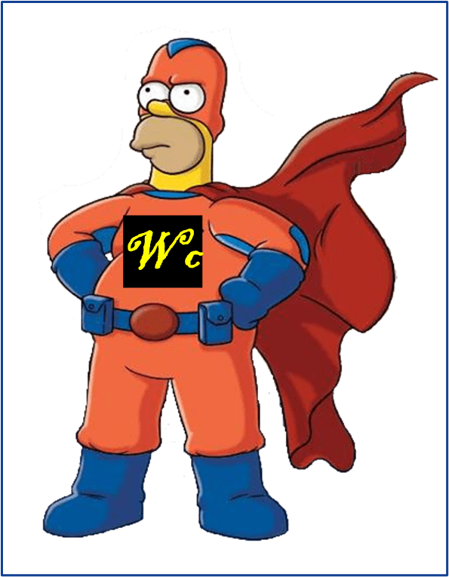
Recap Connecting & Consideration Fundamentals
We are workforce development professionals, working in consultative sales
We work to provide custom staffing solutions that “add value” for the business customers
We are curious beings focused on learning and building rapport
We aspire to be Trusted Advisors for our business partners

Slide 4
Major Phases of the Employer Engagement
1. Connection
2. Consideration
3. Conversion
4. Continuation
Adapted from: How to Master All 5 Stages of Customer Journey https://www.goldenvineyardbranding.com/blog/stages-of-the-customer-journey/
Notes:
refuse

Slide 5
Overview-Conversion & Continuation
ABCs of Selling
Interest-Based Negotiation
Myths & Objections
Ongoing Engagement

Slide 6
ABCs of Selling

Slide 7
Updated ABCs of Selling
Attunement Buoyancy Clarity
Focus on the employer’s needs Positive resilience Commitment to finding, understanding & curating problems

Slide 8
https://happyspree.app/feel-happier-now-how-the-3-ps-of-learned-optimism-can-increase-happiness/

Slide 9
So reminder what we’re “selling”
Employment Solutions
Onboarding & Ongoing Support
Technical Assistance
Education
Intro to new community (“new customers”)

Slide 10
Art of Negotiation

Slide 11
Getting to Yes- Principled Negotiations

Slide 12
Break out
Identify some typical
Employer “Interests”
behind their “Positions”

Slide 13
Mutual Interests in our field
Good job matches
Long term hires
Additional hires
Direct connection with hiring manager
Better qualified, screened candidates
Jobs that are flexible, adaptable and accept accommodations
Jobs that encourage ongoing assistance
Good job matches
Lower cost of hiring
Lower cost of training
Higher retention/lower turnover
Lower cost for higher performance
Increased quality
Increased safety
Reduce waste, poor use of expensive resources

Slide 14
BATNA-best alternative to non-agreement
Part time
Paid Internship
Paid work trial
Are there other alternatives that are acceptable
What is NOT ACCEPTABLE?

Slide 15
Break

Slide 16
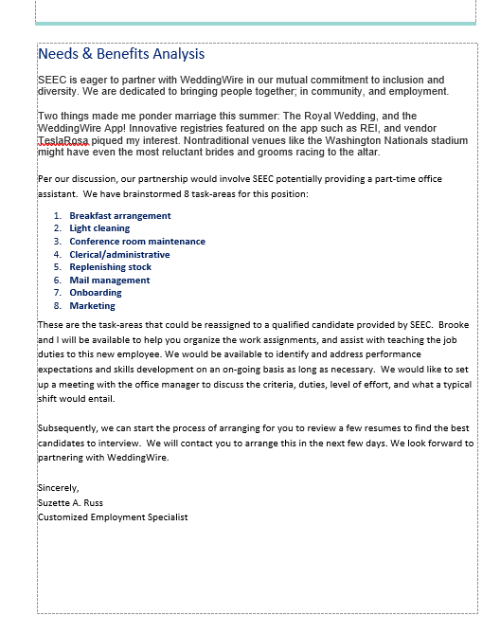
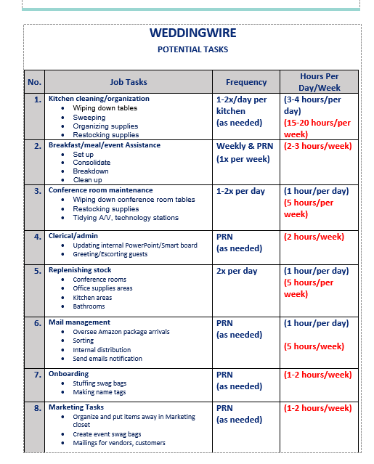
Professional Proposals-Needs & Benefit Analyses

Slide 17
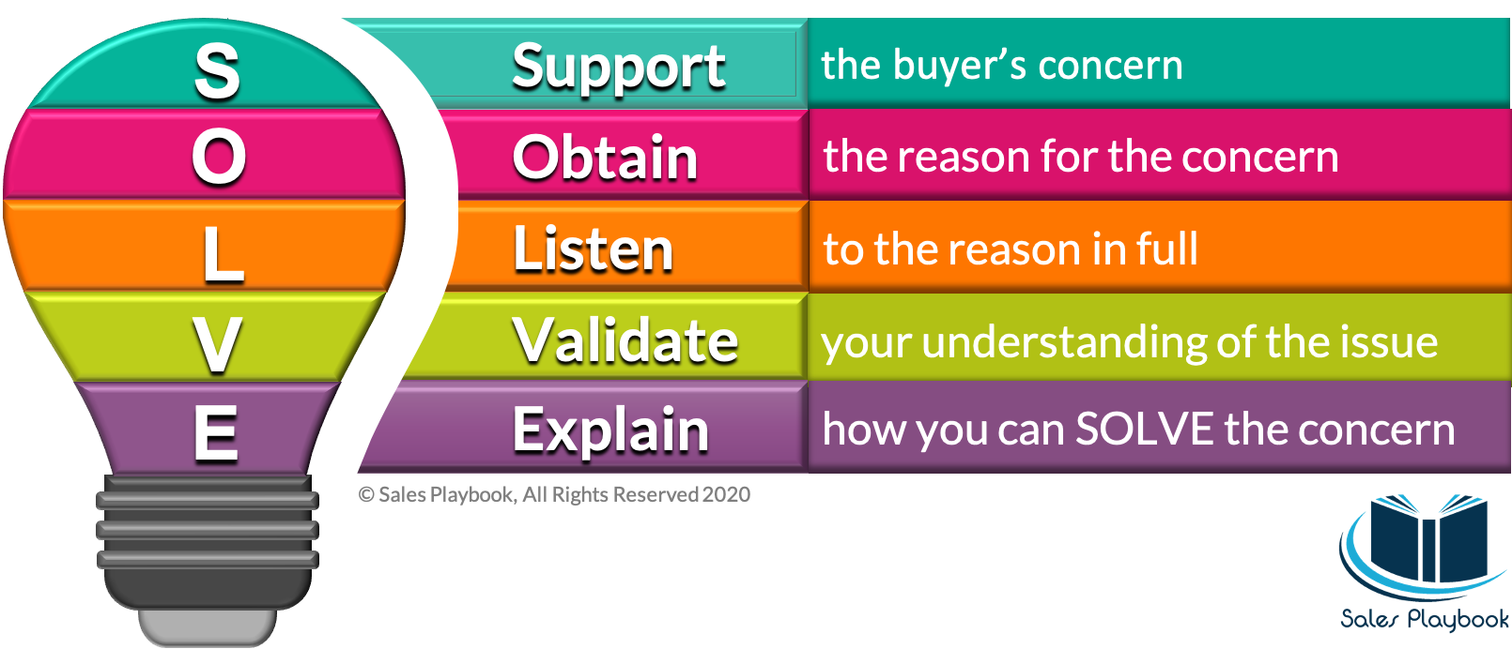
Take Objections or Barriers Head On
https://salesplaybookb2b.com/framework-for-objection-handling
Notes:
So in selling we come across objections right….I can’t do this as my work is too hard, too complex, too unsafe, busy, noisy, etc…etc….and we’ve all heard about the various myths around hiring people with disabilities….well I will touch on some of the big ones, but the idea of handling objections or barriers is something we all have to think about….we always have 2 options…..cross our fingers and hope they don’t come up, and if they do bumble our way through some responses….not dieal….I do think we can all agree if we can foresee some of the typical objections that may come up (in a manufacturing area safety maybe a big one, in a highly controlled lab maybe complexity, etc)….we should resolve to have some answers in our back pocket….and if we get stumped, or new objections or unique challenges get raisesd…….I really liked this simple pneumonic SOLVE…… As we have always been told…..at first show empathy for the customer…..recognize and acknowledge their concern….try to obtain the why behind it by getting more information, more history, more insights….be curious…..maintain active listending and then reflecting….making sure you sound back to the employer what you believe you heard….to hone the reasons, to ensure the employer is fully heard…..and then (if you’re able) let them know how you will address…. A lot of times we have the fortune of ongoing coaching as a solution….or adapted instruction guides that we help make….or technology for the job seeker…..and this is why work trials are critical as you really want to see THAT job seeker in THAT role and environment to truly understand the concern….general concerns can have general answers….

Slide 18
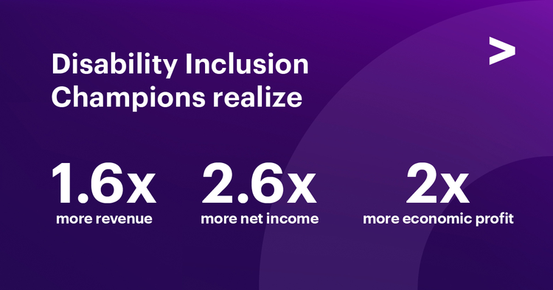
Objection or Myth to Overcome- #1 Performance
In 1990, DuPont survey found that 90 % of employees with disabilities rated average/better in job performance. Similar studies in 1973 and 1981 found employees with disabilities rated higher than their peers without disabilities.
A 2002 study VCU’s Rehabilitation Research and Training Center found employees with disabilities “are as capable & productive” as employees without disabilities
According to Bureau of Labor Statistics, businesses that include employees with disabilities see a 72 percent increase in employee productivity.
At 10 of 13 Walgreen’s distribution centers, employees with disabilities were more productive than those without
Source: Getting to Equal; The Disability Inclusion Advantage, https://www.accenture.com/content/dam/accenture/final/a-com-migration/pdf/pdf-89/accenture-disability-inclusion-research-report.pdf https://discoverability.networks/benefits-of-hiring

Slide 19
Objection or Myth to Overcome- #2 Attendance
According to a study done by the DuPont Corporation (1993), 86% of the employees with disabilities were rated above average or average in their attendance as compared to their non-disabled counterparts. Olsen, Cioffi, Yovanoff, and Mank (2001) found in their study of employers’ perceptions of employees with cognitive disabilities that the amount of sick time and costs of absenteeism were the same or lower for employees with a disability Blanck and Braddock (1998) found in a study that all the employers surveyed reported that their disabled employees had comparable absentee rates.
Source: People with Disabilities: A new model of productive labor, 2012 https://scholars.unh.edu/cgi/viewcontent.cgi?article=1017&context=hospman_facpub

Slide 20
Objection or Myth to Overcome- #3 Safety/Workmen’s Comp Issues
DuPont report (various years) In the 1973 study, there were no incidences of time lost due to disabling injuries. In the 1981 study, 96% of the disabled employees were rated as average or above average in safety. The rate in 1991 was even better, at 97% of disabled employees rated as average or above average (Lengnick-Hall et al., 2008). Blanck and Braddock report (1998) 93% of employers stated they do not believe disabled workers create a safety risk
Employees with disabilities have a 40% lower safety incident rate and 78% lower overall costs associated with accidents than their non-disabled peer employees (Brock University report)
To Note: Workmen’s Comp is never determined by whether your staff have disabilities…solely by health& safety risk of business, size of business and company’s health and safety record (Brock University report)
Source: People with Disabilities: A new model of productive labor, 2012 https://scholars.unh.edu/cgi/viewcontent.cgi?article=1017&context=hospman_facpub
Myths about hiring people with disabilities, Brock University https://brocku.ca/ccee/hirebrocku/bridge-to-success-for-employers/myths/

Slide 21
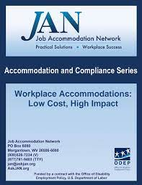
Myths to Overcome- #4 Costly Accommodations
JAN Survey: Of 1,029 employers who provided cost information related to accommodations they had provided, 571 (56%) said the accommodations needed by their employee cost absolutely nothing.
Another 403 (39%) experienced a one-time cost. Median onetime expenditure employer was $500.
Only 46 (4%) said the accommodation resulted in an ongoing, annual cost to the company
When asked how much they paid for an accommodation beyond what they would have paid for an employee without a disability, the median answer given by employers was $20. JAN (2018): 89% of the survey respondents stated accommodations helped retain employees, 72% reported improved employee productivity, 56% noted increased employee attendance, 38% savings in workmen’s comp and insurance rates
Source: https://askjan.org/publications/index.cfm

Slide 22
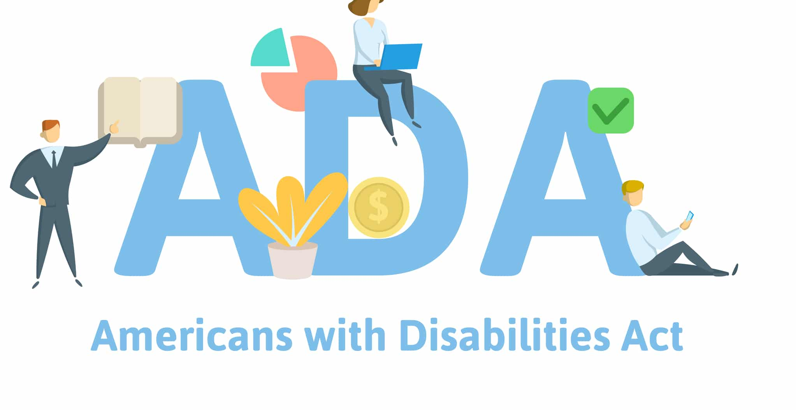
Objection or Myth to Overcome- Other
Turnover of Employees with Disabilities is High
A 3 year study at Washington Mutual found a turnover rate of 8% among persons with IDD vs 45% overall
Marriott reported a 6% turnover among persons with disabilities versus 52% overall
Managing Employee with Disability is Hard
A Harris Report found that 82% of managers said employees with disabilities were no harder to supervise than employees without disabilities.
Firing Employee With A Disability is Impossible
Unqualified applicants cannot claim discrimination under ADA. & employees can be terminated when
it is unrelated to disability,
they do not meet legitimate requirements of the job (with or without reasonable accommodation)
they pose a direct threat to health & safety for the workplace
Employees with Disabilities Can’t Fail
“Dignity of Risk” is a concept we deal with all the time….if we don’t give people with disabilities the opportunities to fail and learn, they will never grow…just like everyone else
Source: Disability Employment Stigmas and Misconceptions, Arc of Bartholomew County https://thearcbc.org/blog/disability-employment-misconceptions
Myths and Facts; About People with Disabilities, Indiana State https://www.in.gov/spd/files/Myth.pdf
People with Disabilities, UNH Report https://scholars.unh.edu/cgi/viewcontent.cgi?article=1017&context=hospman_facpub

Slide 23
Conversion Recap
Attunement to employer’s perspective, Buoyancy through the process and Clarity on solutions
Focus on Interests (over positions)
Maintain commitment to long term relationship (even though short-term losses may occur)
Be prepared to tackle objections head on
Leverage research to address in objections

Slide 24
Continuation-Deepening Relations
Stakeholder Activities | Persons with Disabilities | Families | Providers | Employers | Sector/ Industry Leaders | State Agencies/ Schools
Co-Create NDEAM Celebration/ Recognition Events | X | X | X | X | X | X
Co-Create Social Media Postings | X | X | X | X | X | X
Co-Create Collaboratives | X |  | X | X |  | X
Join Regional/State Leadership Councils | X | X | X | X | X | X
Invite Peer Employers to Learn More |  |  | X | X | X
Co-Create Testimonials | X | X | X | X | X
Co-Create Articles for Industry Journals |  |  | X | X | X

Slide 25
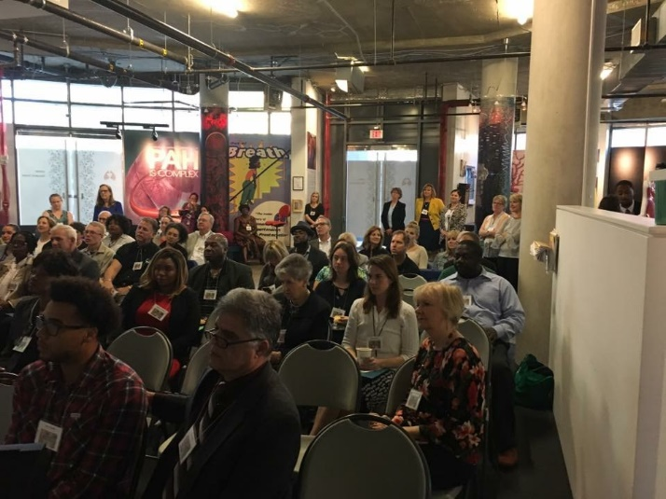
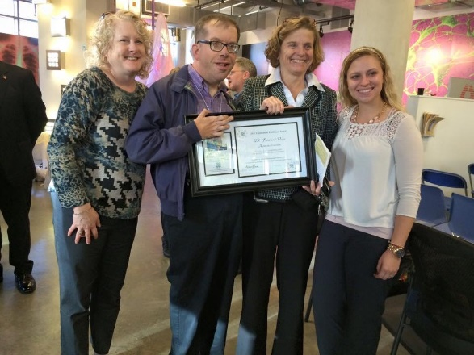
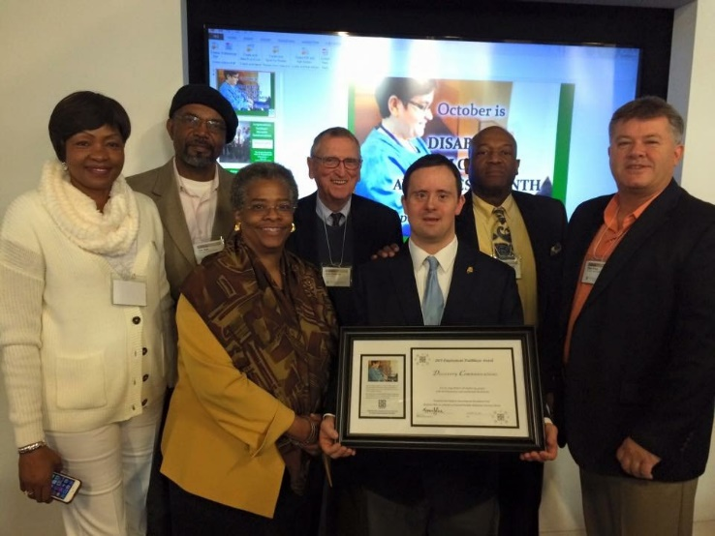
Start by Recognizing Employers

Slide 26
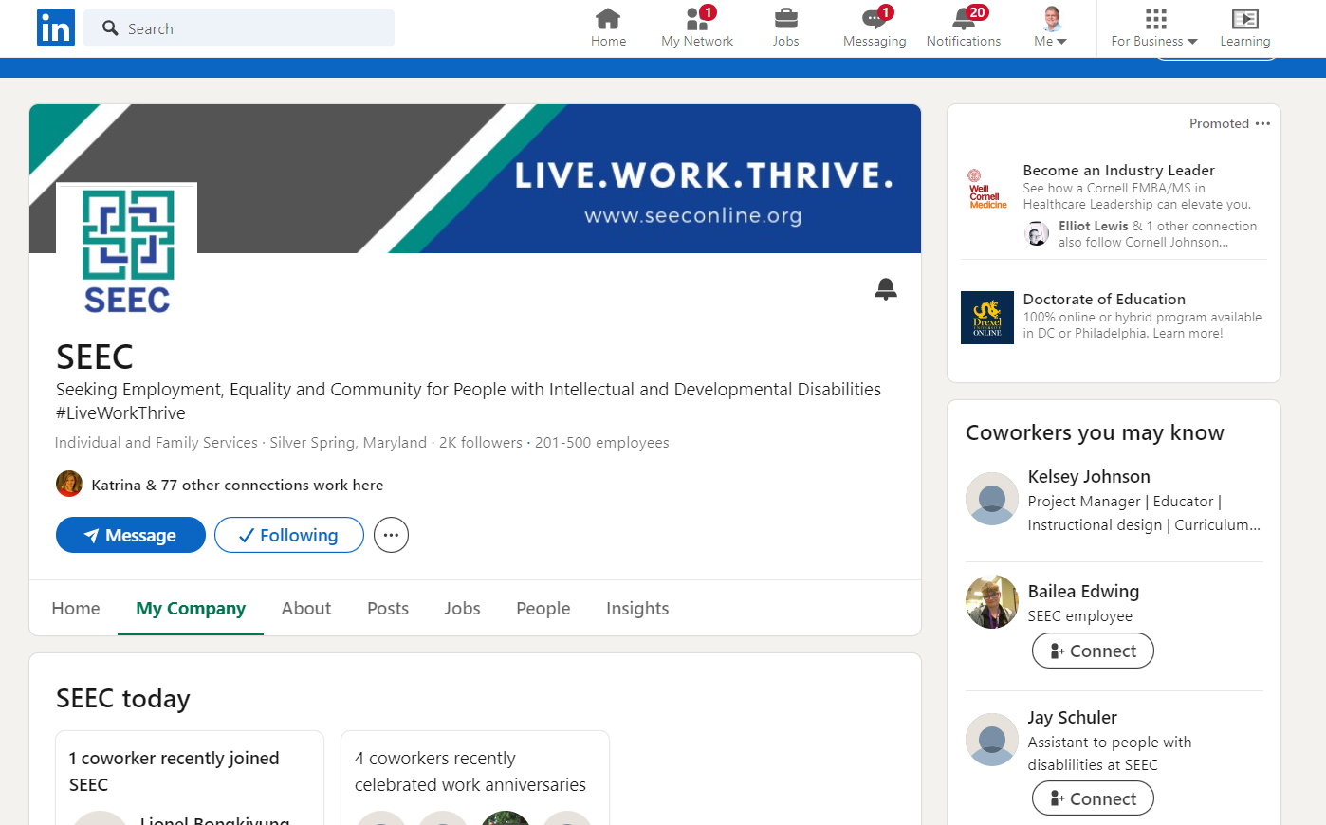
Agency Linked In Page

Slide 27
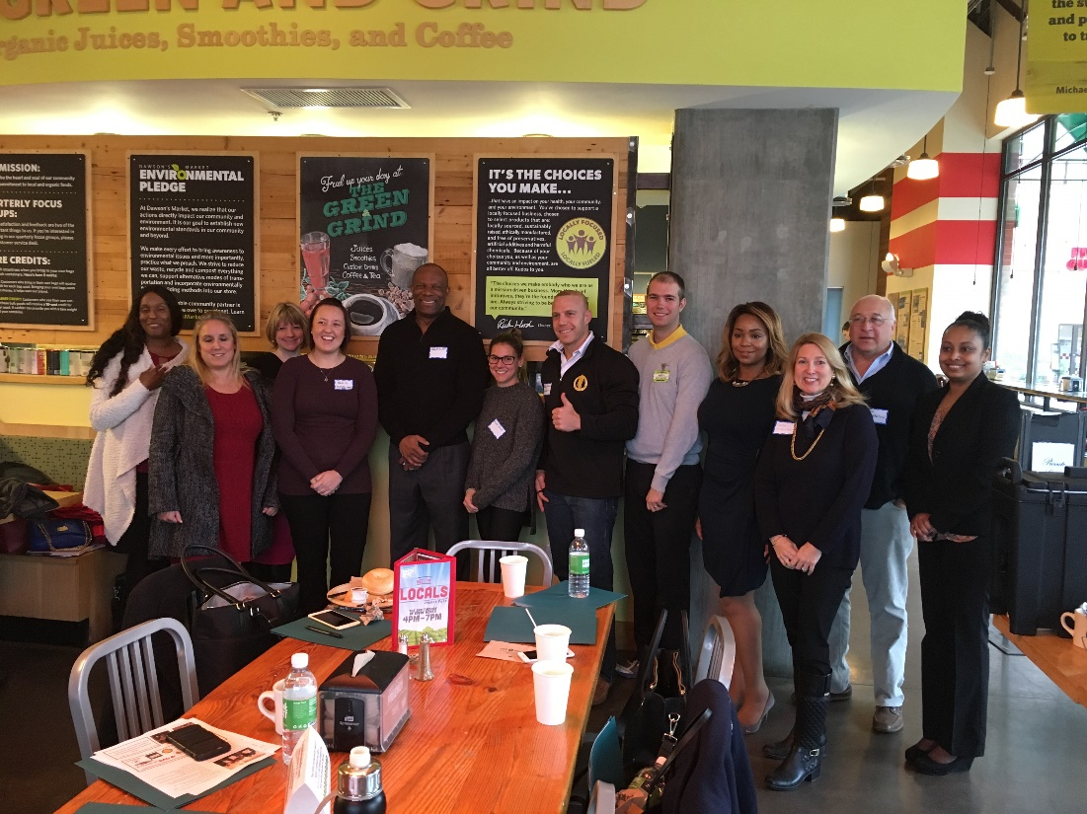
Continuation- Business Advisory Councils
A Business Advisory Council (BAC) is a motivated group of local business and community professionals who assist in….
General Networking
Business-orientation
Marketing feedback
Strategic feedback
Industry connections/invites

Slide 28
Develop Your/Their Why for the group
Our Why | Employer Why
Share professional contacts and networks for our teams to cultivates Provide feedback to our job seekers and support staff on how best to present/market ourselves Hire skilled entry-level job seekers Give feedback about resumes and portfolios Provide workplace experiences-work trials, tours, and shadowing opportunities Host mock interview events Host one of our skilled and motivated interns | Networking with like-minded business leaders and professionals Education and training around disability-related topics Opportunity to highlight your business by hosting one of the meetings Way to give back to your local community Supply of skilled entry level staff

Slide 29
How does it operate
What
Where
When
Meeting Bi-Monthly
1 hour meetings at 4-5pm virtually (now)
Option-rotate hosting
Topics
Sharing and Bragging –for all members
Meet a Job Seeker or two
Review of Previous Job Seeker Status
Discussion of Ways BAC Can Help
Upcoming events, info, webinars, etc

Slide 30
Provider Collaboratives- possible solution to help bridge providers-employers
Employers
2014
2018
2010
Community Providers
Job Seekers
https://www.employmentcollaborative.com/
https://coalitionfwd.com/
https://www.linkedin.com/company/mogatewaynexus/

Slide 33
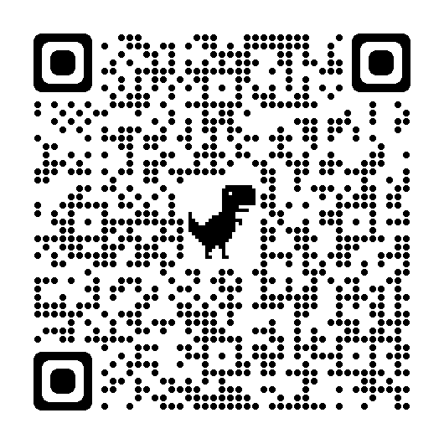
Steve Blanks
Director of Partnerships
SEEC
sblanks@seeconline.org
https://www.linkedin.com/in/steve-blanks-5a16474/details/skills/?detailScreenTabIndex=0

Slide 34
Resource List around Myths
Getting to Equal; The Disability Inclusion Advantage, https://www.accenture.com/content/dam/accenture/final/a-com-migration/pdf/pdf-89/accenture-disability-inclusion-research-report.pdf
People with Disabilities: A new model of productive labor, 2012 https://scholars.unh.edu/cgi/viewcontent.cgi?article=1017&context=hospman_facpub
Myths about hiring people with disabilities, Brock University https://brocku.ca/ccee/hirebrocku/bridge-to-success-for-employers/myths/
Benefits of Hiring, Discoverability Network https://discoverability.networks/benefits-of-hiring
JAN Work Accommodation Report https://askjan.org/publications/index.cfm
Disability Employment Stigmas and Misconceptions, Arc of Bartholomew County https://thearcbc.org/blog/disability-employment-misconceptions
Myths and Facts; About People with Disabilities, Indiana State https://www.in.gov/spd/files/Myth.pdf
People with Disabilities, UNH Report https://scholars.unh.edu/cgi/viewcontent.cgi?article=1017&context=hospman_facpub

