Slide 1
Sample Title Page
Employer Engagement Webinar Series
1. Creating Awareness
Kentucky Employment First
June 20, 2024
Notes:
We will have a POLLEV runni

Slide 2
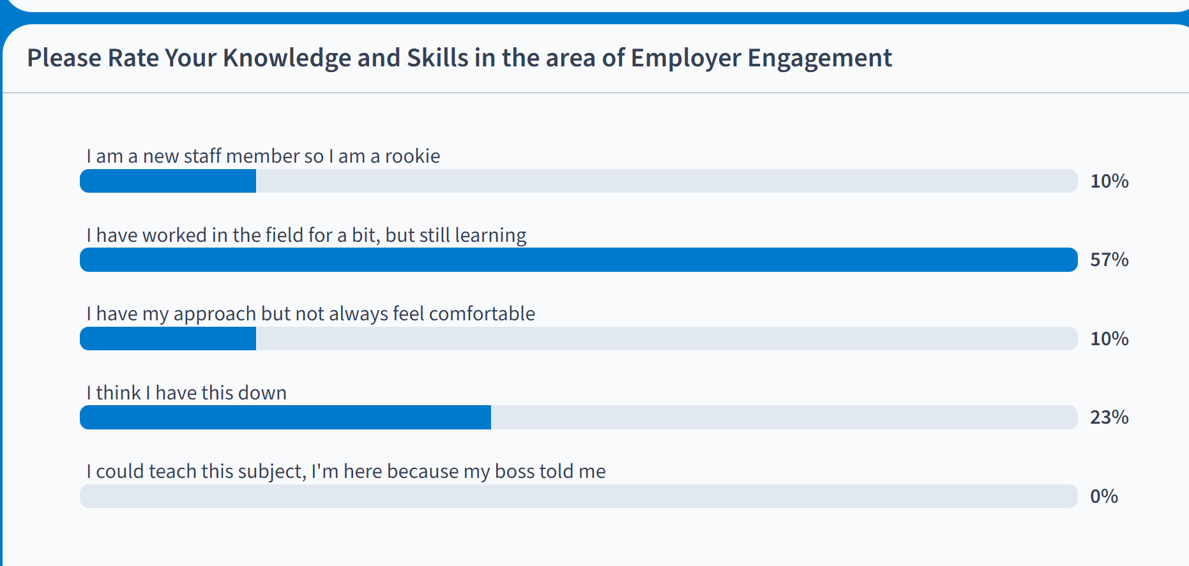

Slide 3
Speaker-Steve Blanks
A 20+ year veteran of the Intellectual & Developmental Disability (IDD) industry in MD
Subject Matter Expert in Employment Services across US
Current Director of Partnerships at SEEC
Brother of person with IDD
“I have no special talents. I am only passionately curious.” - Albert Einstein

Slide 4
Why is Engagement Vital Up to 85% of jobs are filled via networking

Slide 5
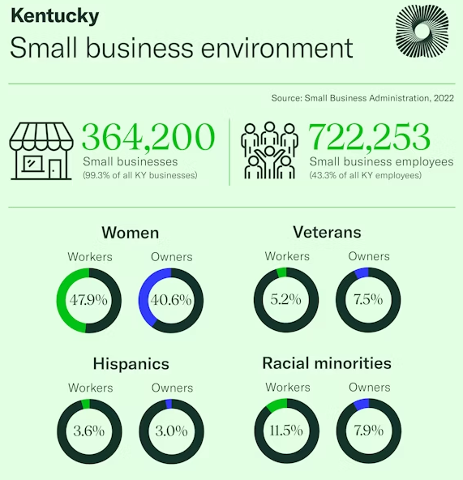
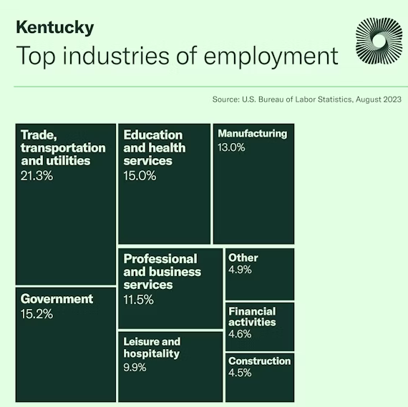
KY has 74 people for every 100 open jobs
https://www.uschamber.com/workforce/understanding-kentuckys-labor-market?state=ky

Slide 6
Major Phases of the Employer Engagement
1. Connection
2. Consideration
3. Conversion
4. Continuation
Adapted from: How to Master All 5 Stages of Customer Journey https://www.goldenvineyardbranding.com/blog/stages-of-the-customer-journey/

Slide 7
Overview-Connecting
Foundational Business Practices and Mindset
Business-centric language and approach
Concept of Adding Value
Networking-what, where and how
Digital Networking

Slide 8
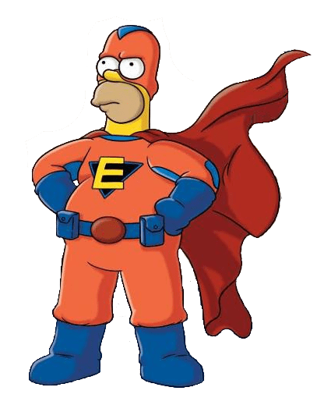
Shift Your Thinking
Job Seeker
Workforce Professional
Business
W

Slide 10
Business Speak

Slide 11
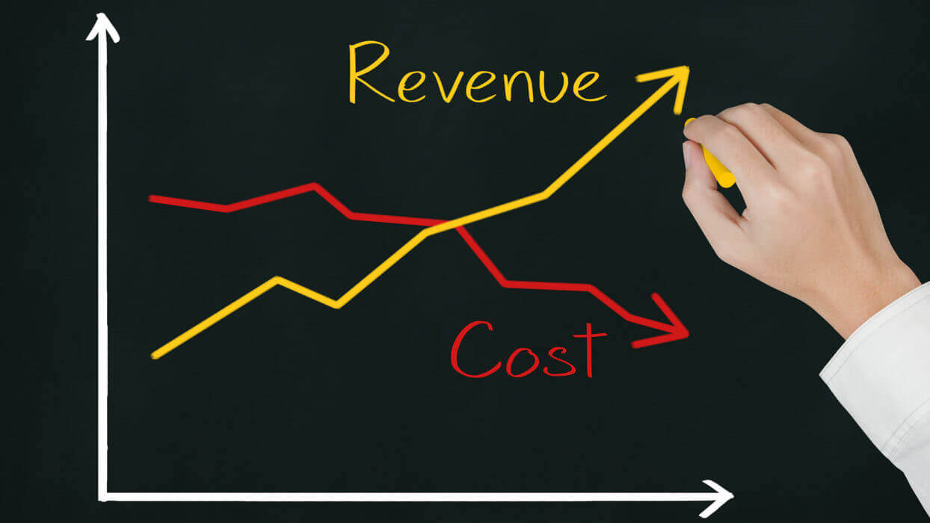
Business Drivers…..what drives how they act?

Slide 12
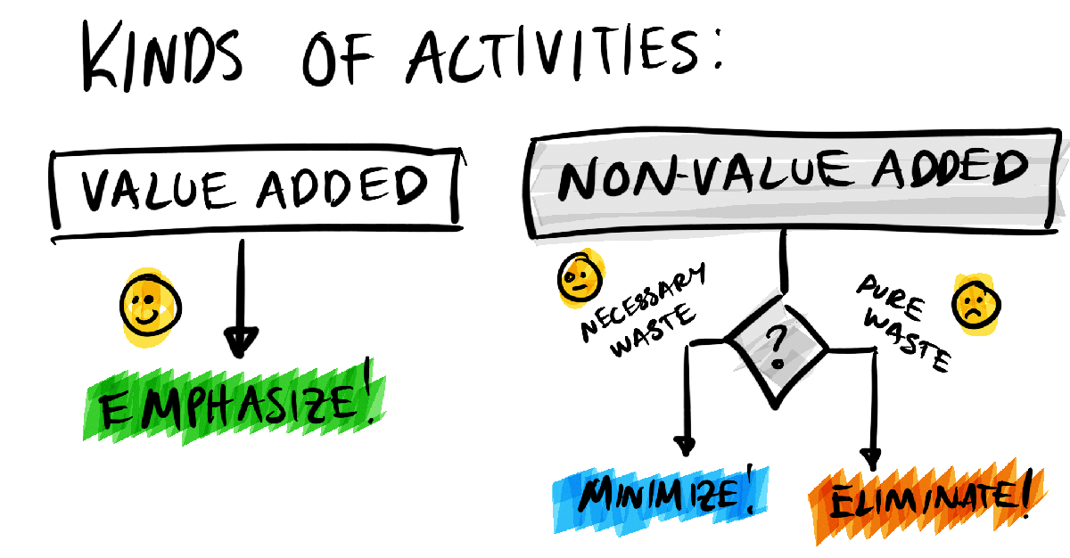
Business Language-Adding Value

Slide 13
Break Out 1

Slide 14
What Else do businesses care about….
Image and reputation
Community connectivity
Targeted customers (possibly)
Environment
Diversity, Equity & Inclusion

Slide 15
Be Professional

Slide 16
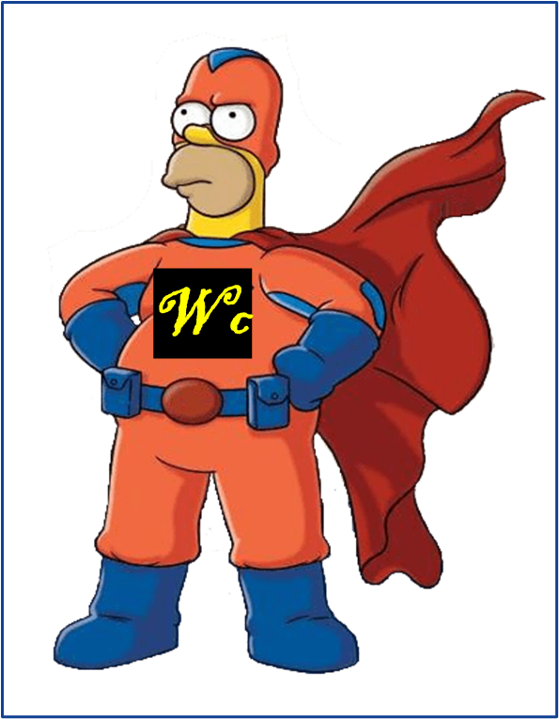
Recap
You are workforce development professionals
You work in consultative sales
You work to provide custom staffing solutions
You strive to “add value” for the business customers

Slide 17
Who, What, Where & How– Employer Prospecting & Networking

Slide 18
Networking Why

Slide 19
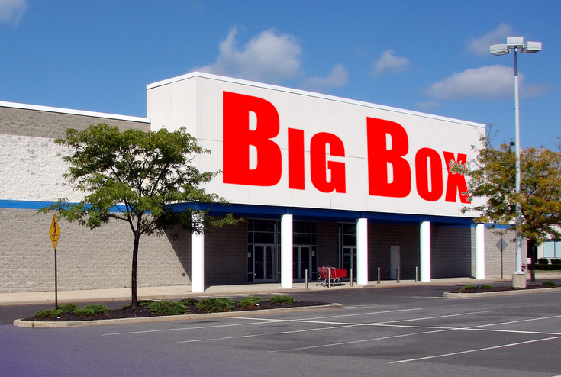
Typical outreach strategies…..
Asking directly about jobs
Cold call businesses
Walk/drive the streets looking for big/visible businesses
Attempt to get into businesses with no “in”

Slide 20
Common Mistakes - Big Sign Syndrome
Big business is NOT where the many of jobs are-despite the Now Hiring signs​
Almost 50% of employees are in small biz (<500emplyee)​
Almost 90% of biz employ <20 employees​ ​
32 Million small businesses vs only 21 >500 employees​
22 Million self employed-with no employees​ ​
66% of new job growth has been in small biz over last 25 years

Slide 21
Effectiveness of Outreach
Cold calling 5% response rate
Warm calling 30+% response rate
Hot calling 100%

Slide 22
Networking is everyone’s job
Professional-Mine
Personal-Mine
Personal-Job Seeker
Professional- Agency

Slide 23
The Who- You/Job Seeker
You and Job Seeker
Family
Neighbors
Friends
Colleagues-coworkers
People you connect with –book clubs, sports teams, etc
People you transact with – grocery store, coffee shop., hair salon, school, coaches,

Slide 24
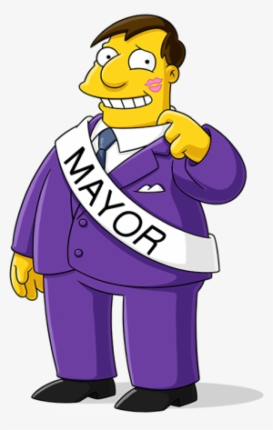
The Who - Agency Connections
Board of Directors
Volunteers
Vendors
Suppliers
Neighbor businesses

Slide 25
To Augment Your Network…..
KY Career Centers
Chambers
Economic development groups (county/city)
Rotary Clubs
Kiwanis
Knights of Columbus
Trade groups

Slide 26
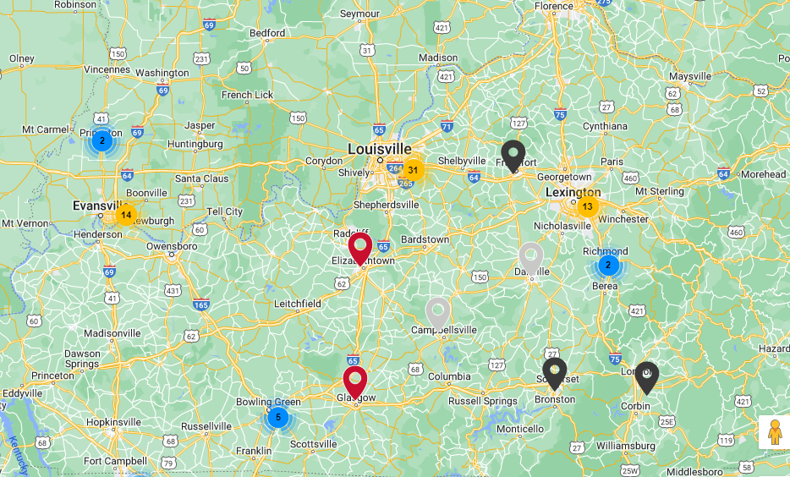
Business Network International

Slide 27
The Intro “Elevator Pitch”

Slide 28
Key elements of an elevator pitch
Intro
What
Why you? What’s different? experience?
Hi, my name is XXX and I’m a workforce development professional here in YYYY with [Insert Company]
[Insert Company] provides custom staffing solutions to businesses of all sizes who are looking to hire entry level workers. We work with you to understand your business and staffing needs, and match pre-screened, qualified job seekers to your critical tasks.
I like to think our hands-on, collaborative approach with employers leads to more stable and reliable workers.
(Or) We work with over 100 businesses throughout the area, who can attest to our services and caliber of job seekers.

Slide 29
Relationship Building-It’s About Giving NOT TAKING
Listen more than talk (GIVE)
Share your expertise (GIVE)
Ask How You Can Help (GIVE)
“If you wake up deciding what you want to give versus what you’re going to get, you become a more successful person…..if you want to make money, you have to help someone else make money.” Russell Simmons, Def Jam Recordings
Be Your Genuine Self (GIVE)

Slide 30
Weak or Dormant Ties
https://medium.com/invinciblecareer/the-surprising-value-of-weak-ties-d63a10b92e5c

Slide 31
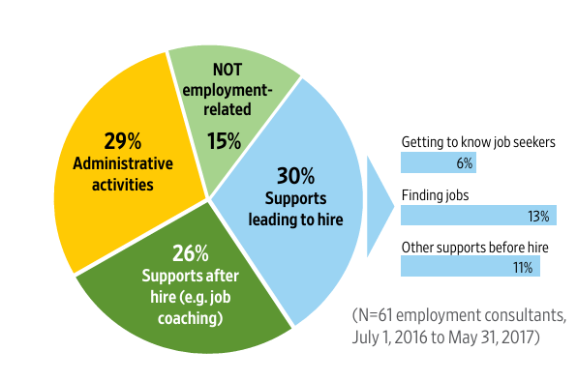
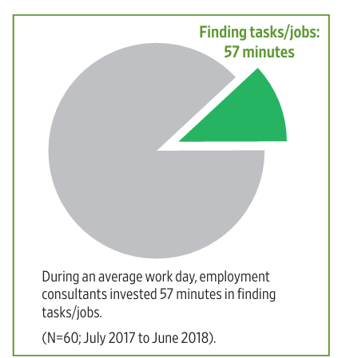
How time is spent……Connecting
https://scholarworks.umb.edu/cgi/viewcontent.cgi?article=1140&context=ici_pubs https://scholarworks.umb.edu/cgi/viewcontent.cgi?article=1102&context=ici_pubs

Slide 32
Connection-Raising Awareness
Stakeholder Activities | Persons with Disabilities | Families | Providers | Employers | Sector/ Industry Leaders | State Officials/ Schools
Share Employment Stories | X | X | X | X | X | X
Provide Education | X | X | X | X | X | X
Share Testimonials | X | X | X | X | X | X
Invite to Industry Groups/Biz Groups |  | X |  | X | X
Post in Social Media | X | X | X | X | X | X
Invite to NDEAM events |  |  | X | X | X | X
Develop Marketing Materials (videos, etc) |  |  | X | X | X | X

Slide 33
So what you gonna do……
Notes:
We will send out a survey with some notes for feedback about session, content, etc but also with a call 2 action…..what you gonna do

Slide 34
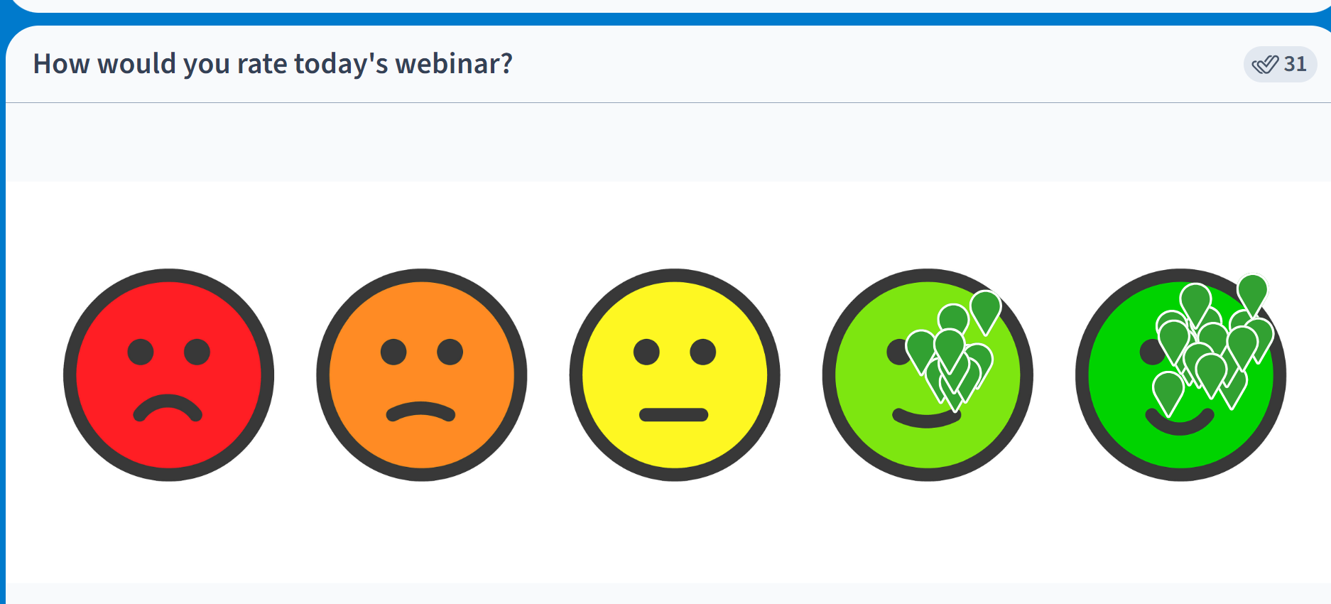

Slide 35
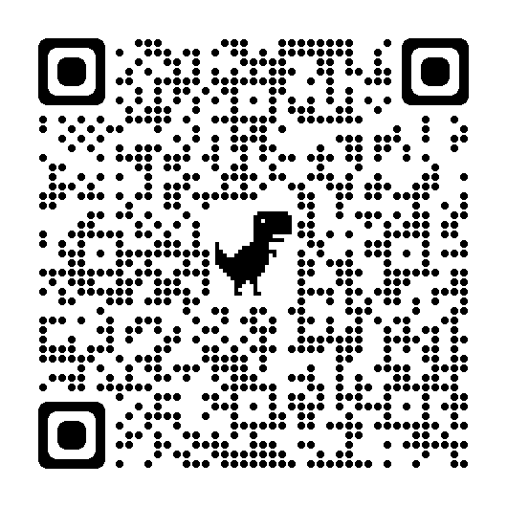
Steve Blanks
Director of Partnerships
SEEC
sblanks@seeconline.org
https://www.linkedin.com/in/steve-blanks-5a16474/details/skills/?detailScreenTabIndex=0

Slide 36
Resources
General
Job Developer’s Handbook Griffin,Hammis and Geary, Griffin Hammis Associates
Adam Grant Organizational Psychologist resources www.adamgrant.net
Simon Sinek www.simonsinek.com
Research & Statistics
ICI UMASS Think Work www.ici.umb.edu
US Bureau of Labor www.bls.gov
Kentucky Workforce Info https://www.uschamber.com/workforce/understanding-kentuckys-labor-market?state=ky
Networking Related
Business Network International (BNI) www.bni.com
LinkedIn resources www.linkedin.com
Fortune’s Best Networker (Adam Rifkin story) https://bakadesuyo.com/2013/02/interview-silicon-valleys-networker-teaches-secrets-making-connections/ https://www.adambraun.com/insights/strong-power-weak-ties#:~:text=Kim%20Keating%20references%20this%20here,novel%20information%20than%20strong%20ties.

